Slide 1
Support Vector Machines and Kernels
Doing Really Well with
Linear Decision Surfaces
Adapted from slides by Tim Oates
Cognition, Robotics, and Learning (CORAL) Lab
University of Maryland Baltimore County

Slide 2
Outline
Prediction
  Why might predictions be wrong?
Support vector machines
  Doing really well with linear models
Kernels
  Making the non-linear linear

Slide 3
Supervised ML = Prediction
Given training instances (x,y)
Learn a model f
Such that f(x) = y
Use f to predict y for new x
Many variations on this basic theme

Slide 4
Why might predictions be wrong?
True Non-Determinism
  Flip a biased coin
  p(heads) = θ
  Estimate θ
  If θ > 0.5 predict heads, else tails
  Lots of ML research on problems like this
    Learn a model
    Do the best you can in expectation

Slide 5
Why might predictions be wrong?
Partial Observability
  Something needed to predict y is missing from observation x
  N-bit parity problem
    x contains N-1 bits (hard PO)
    x contains N bits but learner ignores some of them (soft PO)

Slide 6
Why might predictions be wrong?
True non-determinism
Partial observability
  hard, soft
Representational bias
Algorithmic bias
Bounded resources

Slide 7
Representational Bias
Having the right features (x) is crucial
X
X
X
X
O
O
X
X
O
O
O
O
X
X
O
O

Slide 8
Support Vector Machines
Doing Really Well with Linear Decision Surfaces

Slide 9
Strengths of SVMs
Good generalization in theory
Good generalization in practice
Work well with few training instances
Find globally best model
Efficient algorithms
Amenable to the kernel trick

Slide 10
Linear Separators
Training instances
  x ∈ ℜ^{n}
  y ∈ {-1, 1}
w ∈ ℜ^{n}
b ∈ ℜ
Hyperplane
  <w, x> + b = 0
  w₁x₁ + w₂x₂ … + w_{n}x_{n} + b = 0
Decision function
  f(x) = sign(<w, x> + b)
Math Review
Inner (dot) product:
  <a, b> = a · b = ∑ a_{i}*b_{i}
  = a₁b₁ + a₂b₂ + …+a_{n}b_{n}

Slide 11
Intuitions
O
X
O
X
O
X
X
O
O
X
O
X
X
O
O
X

Slide 12
Intuitions
O
X
O
X
O
X
X
O
O
X
O
X
X
O
O
X

Slide 13
Intuitions
O
X
O
X
O
X
X
O
O
X
O
X
X
O
O
X

Slide 14
Intuitions
O
X
O
X
O
X
X
O
O
X
O
X
X
O
O
X

Slide 15
A “Good” Separator
O
X
O
X
O
X
X
O
O
X
O
X
X
O
O
X

Slide 16
Noise in the Observations
O
X
O
X
O
X
X
O
O
X
O
X
X
O
O
X

Slide 17
Ruling Out Some Separators
O
X
O
X
O
X
X
O
O
X
O
X
X
O
O
X

Slide 18
Lots of Noise
O
X
O
X
O
X
X
O
O
X
O
X
X
O
O
X

Slide 19
Maximizing the Margin
O
X
O
X
O
X
X
O
O
X
O
X
X
O
O
X

Slide 20
“Fat” Separators
O
X
O
X
O
X
X
O
O
X
O
X
X
O
O
X

Slide 21
Why Maximize Margin?
Increasing margin reduces capacity
Must restrict capacity to generalize
  m training instances
  2^{m} ways to label them
  What if function class that can separate them all?
  Shatters the training instances
VC Dimension is largest m such that function class can shatter some set of m points

Slide 22
VC Dimension Example
X
O
X
X
X
X
X
X
O
X
X
O
O
O
X
O
O
X
X
O
O
O
O
O

Slide 23
Bounding Generalization Error
R[f] = risk, test error
R_{emp}[f] = empirical risk, train error
h = VC dimension
m = number of training instances
δ = probability that bound does not hold
1
2m
4
R[f] ≤ R_{emp}[f] +
h
ln
+ 1
+ ln
m
h
δ

Slide 24
Support Vectors
O
X
O
X
O
X
X
O
O
X
O
X
X
O
O
X

Slide 25
The Math
Training instances
  x ∈ ℜ^{n}
  y ∈ {-1, 1}
Decision function
  f(x) = sign(<w,x> + b)
  w ∈ ℜ^{n}
  b ∈ ℜ
Find w and b that
  Perfectly classify training instances
    Assuming linear separability
  Maximize margin

Slide 26
The Math
For perfect classification, we want
  y_{i} (<w,x_{i}> + b) ≥ 0 for all i
  Why?
To maximize the margin, we want
  w that minimizes |w|²

Slide 27
Dual Optimization Problem
Maximize over α
  W(α) = Σ_{i} α_{i} - 1/2 Σ_{i,j} α_{i} α_{j} y_{i} y_{j} <x_{i}, x_{j}>
Subject to
  α_{i} ≥ 0
  Σ_{i} α_{i} y_{i} = 0
Decision function
  f(x) = sign(Σ_{i} α_{i} y_{i} <x, x_{i}> + b)

Slide 28
What if Data Are Not Perfectly Linearly Separable?
Cannot find w and b that satisfy
  y_{i} (<w,x_{i}> + b) ≥ 1 for all i
Introduce slack variables ξ_{i}
  y_{i} (<w,x_{i}> + b) ≥ 1 - ξ_{i} for all i
Minimize
  |w|² + C Σ ξ_{i}

Slide 29
Strengths of SVMs
Good generalization in theory
Good generalization in practice
Work well with few training instances
Find globally best model
Efficient algorithms
Amenable to the kernel trick …

Slide 30
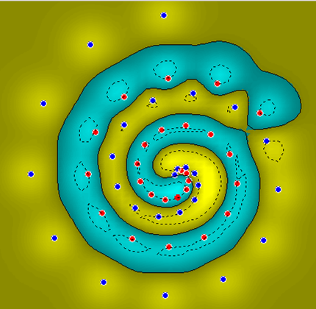
What if Surface is Non-Linear?
O
O
O
O
O
O
O
O
O
O
X
O
X
X
O
X
O
X
X
O
O
O
O
O
O
O
Image from http://www.atrandomresearch.com/iclass/

Slide 31
Kernel Methods
Making the Non-Linear Linear

Slide 32
When Linear Separators Fail
x₂
x₁²
X
X
X
X
x₁
O
O
x₁
X
X
O
O
O
O
X
X
O
O

Slide 33
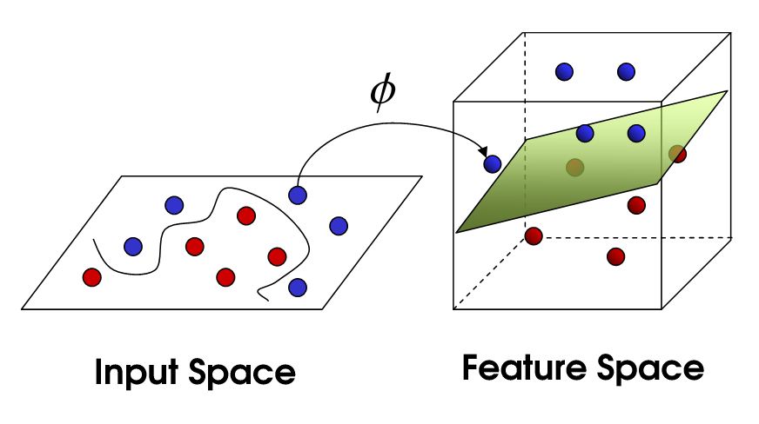
Mapping into a New Feature Space
Φ : x → X = Φ(x)
Φ(x₁,x₂) = (x₁,x₂,x₁²,x₂²,x₁x₂)
Rather than run SVM on x_{i}, run it on Φ(x_{i})
Find non-linear separator in input space
What if Φ(x_{i}) is really big?
Use kernels to compute it implicitly!
Image from http://web.engr.oregonstate.edu/
~afern/classes/cs534/

Slide 34
Kernels
Find kernel K such that
  K(x₁,x₂) = < Φ(x₁), Φ(x₂)>
Computing K(x₁,x₂) should be efficient, much more so than computing Φ(x₁) and Φ(x₂)
Use K(x₁,x₂) in SVM algorithm rather than <x₁,x₂>
Remarkably, this is possible

Slide 35
The Polynomial Kernel
K(x₁,x₂) = < x₁, x₂ > ²
  x₁ = (x₁₁, x₁₂)
  x₂ = (x₂₁, x₂₂)
< x₁, x₂ > = (x₁₁x₂₁ + x₁₂x₂₂)
< x₁, x₂ > ² = (x₁₁² x₂₁² + x₁₂²x₂₂² + 2x₁₁ x₁₂ x₂₁ x₂₂)
Φ(x₁) = (x₁₁², x₁₂², √2x₁₁ x₁₂)
Φ(x₂) = (x₂₁², x₂₂², √2x₂₁ x₂₂)
K(x₁,x₂) = < Φ(x₁), Φ(x₂) >

Slide 36
The Polynomial Kernel
Φ(x) contains all monomials of degree d
Useful in visual pattern recognition
Number of monomials
  16x16 pixel image
  10¹⁰ monomials of degree 5
Never explicitly compute Φ(x)!
Variation - K(x₁,x₂) = (< x₁, x₂ > + 1) ²

Slide 37
Kernels
What does it mean to be a kernel?
  K(x₁,x₂) = < Φ(x₁), Φ(x₂) > for some Φ
What does it take to be a kernel?
  The Gram matrix G_{ij} = K(x_{i}, x_{j})
  Positive definite matrix
    Σ_{ij} c_{i} c_{j} G_{ij} ≥ 0 for c_{i,} c_{j} ∈ ℜ
  Positive definite kernel
    For all samples of size m, induces a positive definite Gram matrix

Slide 38
A Few Good Kernels
Dot product kernel
  K(x₁,x₂) = < x₁,x₂ >
Polynomial kernel
  K(x₁,x₂) = < x₁,x₂ >^{d} (Monomials of degree d)
  K(x₁,x₂) = (< x₁,x₂ > + 1)^{d} (All monomials of degree 1,2,…,d)
Gaussian kernel
  K(x₁,x₂) = exp(-| x₁-x₂ |²/2σ²)
  Radial basis functions
Sigmoid kernel
  K(x₁,x₂) = tanh(< x₁,x₂ > + ϑ)
  Neural networks
Establishing “kernel-hood” from first principles is non-trivial

Slide 39
The Kernel Trick
“Given an algorithm which is formulated in terms of a positive definite kernel K₁, one can construct an alternative algorithm by replacing K₁ with another positive definite kernel K₂”
SVMs can use the kernel trick

Slide 40
Using a Different Kernel in the Dual Optimization Problem
For example, using the polynomial kernel with d = 4 (including lower-order terms).
Maximize over α
  W(α) = Σ_{i} α_{i} - 1/2 Σ_{i,j} α_{i} α_{j} y_{i} y_{j} <x_{i}, x_{j}>
Subject to
  α_{i} ≥ 0
  Σ_{i} α_{i} y_{i} = 0
Decision function
  f(x) = sign(Σ_{i} α_{i} y_{i} <x, x_{i}> + b)
(<x_{i}, x_{j}> + 1)⁴
X
So by the kernel trick,
we just replace them!
These are kernels!
(<x_{i}, x_{j}> + 1)⁴
X

Slide 41
Exotic Kernels
Strings
Trees
Graphs
The hard part is establishing kernel-hood

Slide 42
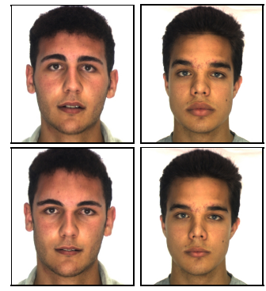
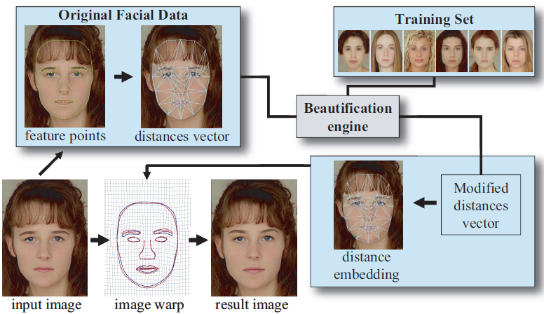
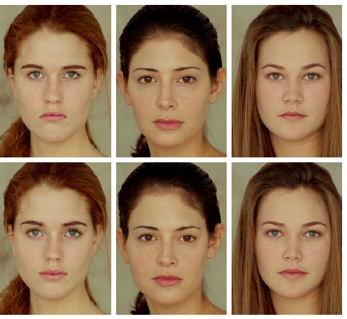
Application: “Beautification Engine”
(Leyvand et al., 2008)

Slide 43
Conclusion
SVMs find optimal linear separator
The kernel trick makes SVMs non-linear learning algorithms

